Slide 1
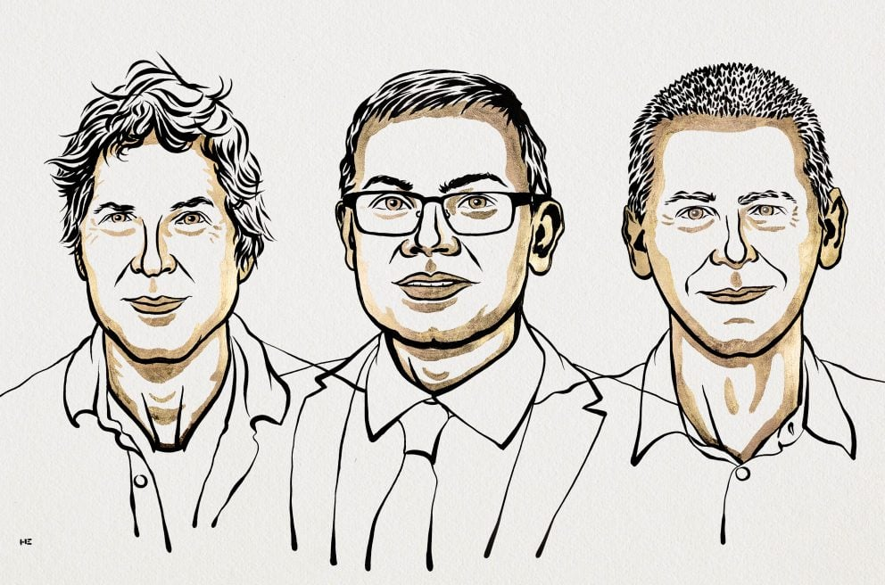
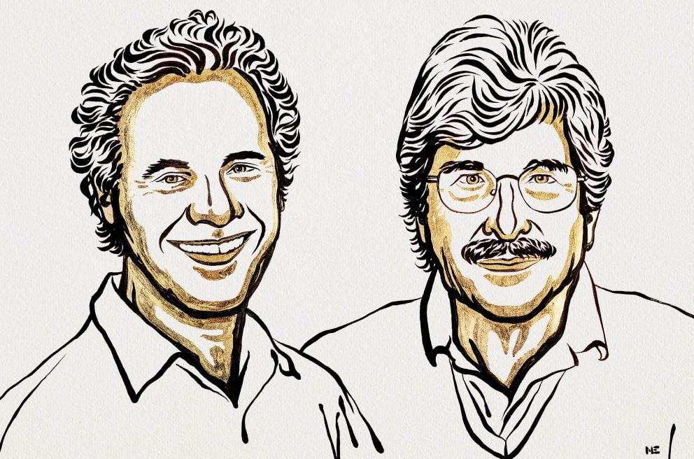
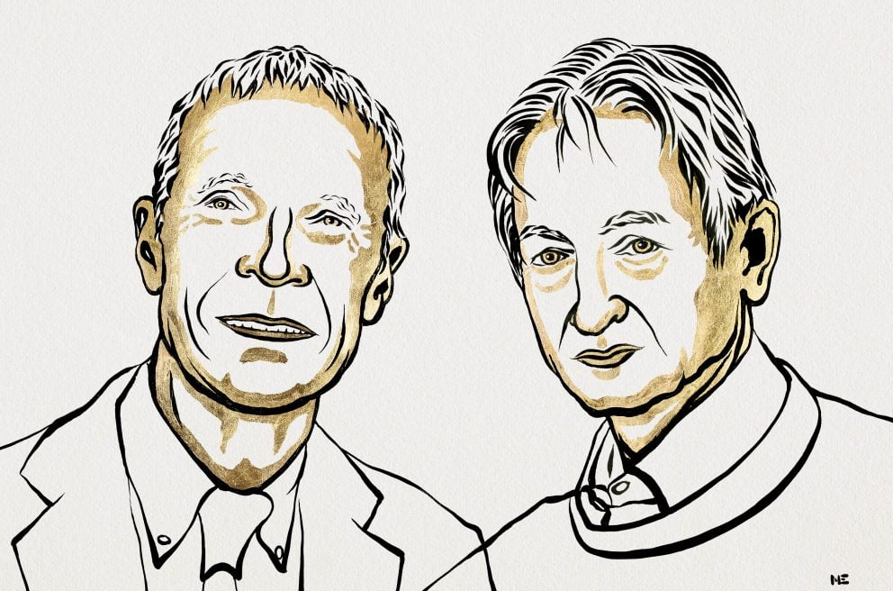
2024 Nobel Prizes!
Chemistry
David Baker - “for computational protein design”
Demis Hassabis and John M. Jumper - “for protein structure prediction”
Physiology or Medicine
Victor Ambros and Gary Ruvkun - “for the discovery of microRNA and its role in post-transcriptional gene regulation.”
Physics
John J. Hopfield and Geoffrey E. Hinton - “for foundational discoveries and inventions that enable machine learning with artificial neural networks.”

Slide 2
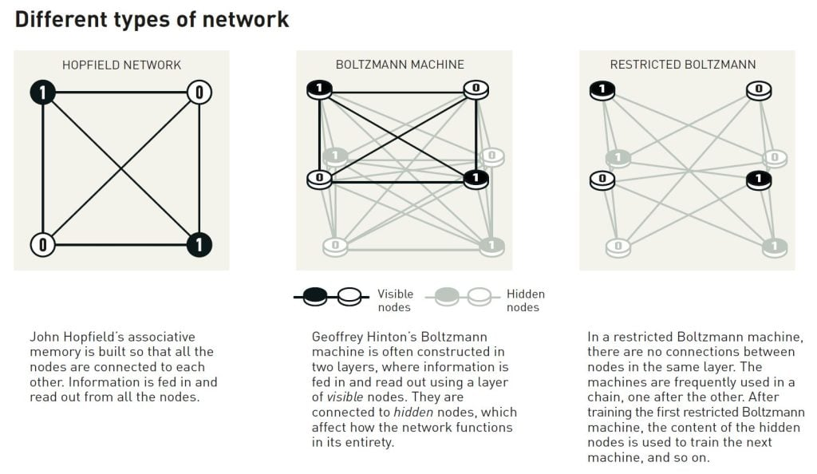
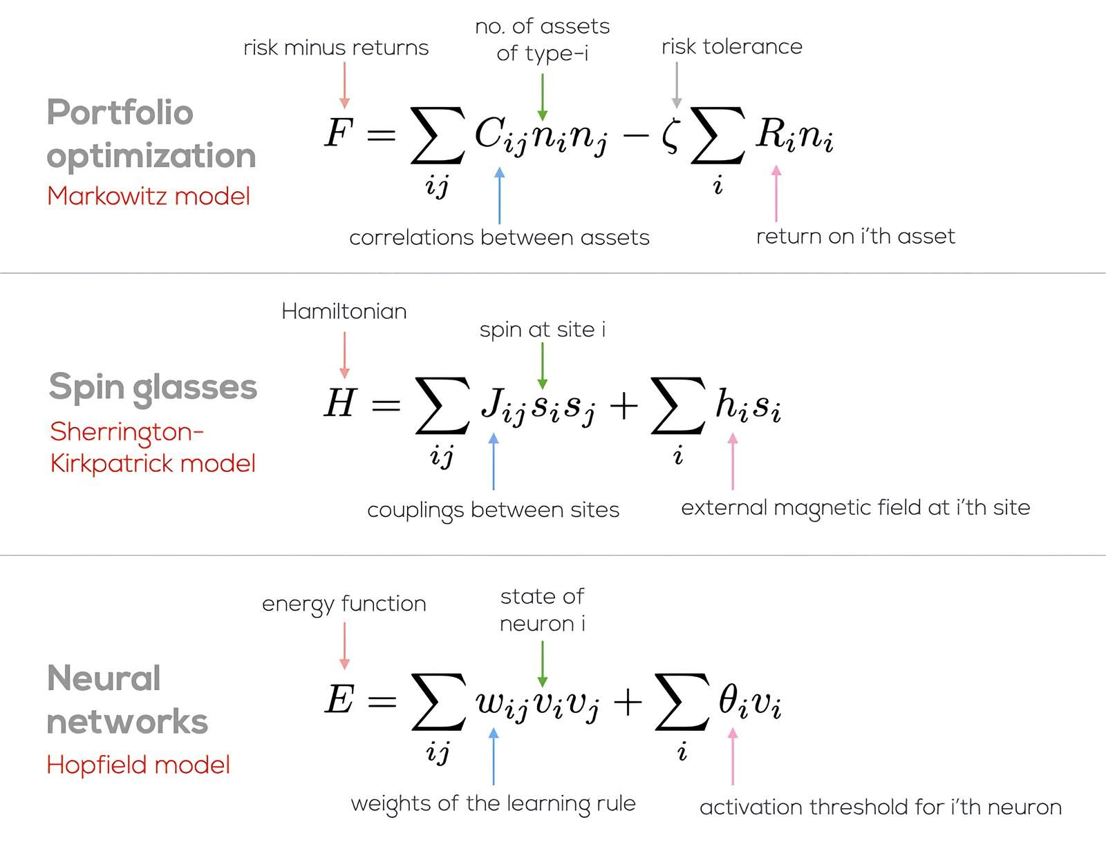
Physics? or AI?

Slide 3


















Some Azure Services
Functions
Batch
CycleCloud
Synapse
Databricks
Storage
Container Registry
Web Apps
Virtual Machines
Data Factory
SQL DB
Container Instances
CosmosDB
Power BI
PostgreSQL
AI Services /
OpenAI
ML Studio
Kubernetes Service

